Slide 1

Elevate Your Brand with CREATIVE QUEST!
Crafting Unforgettable Experiences, Igniting Lasting Impressions!

Slide 2

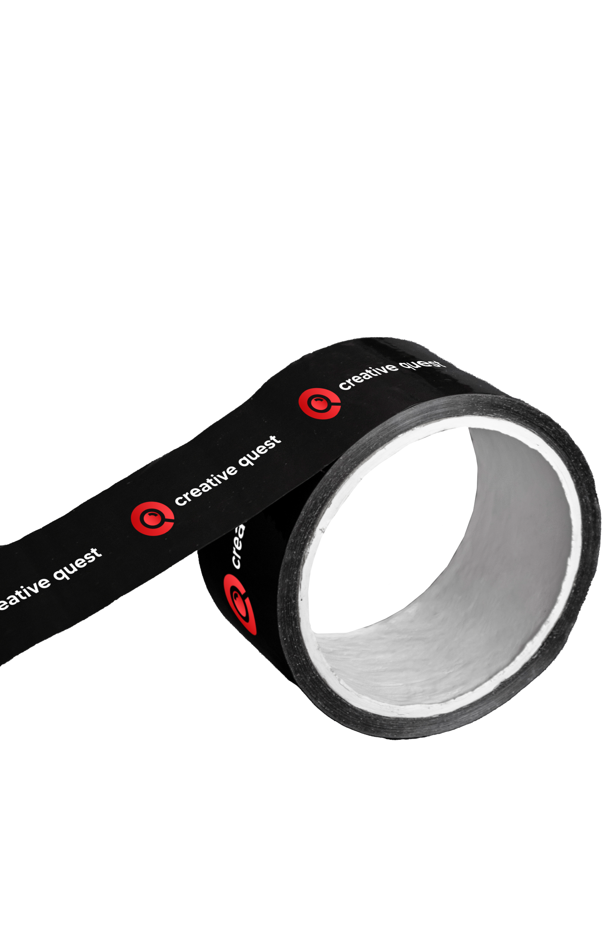

ABOUT US
Who We Are
Your Dynamic Marketing Partner
Established in 2017, formerly Dygiq, Creative Quest is a forward-thinking marketing agency dedicated to creating extraordinary experiences for brands.
Our team of seasoned professionals is passionate about innovation, creativity, and delivering results that resonate.

Slide 3


CORE SPECIALIZATIONS
Our Expertise
Tailored Solutions for Your Brand
Events
Booth Fabrication
Meticulously crafted events that leave a lasting impact.
Transform your booth into an immersive experience.
Promotions
Social Media Management
Strategic campaigns that captivate and drive conversions.
Harness the power of social media for brand growth.
Giveaways
Creatives
Elevate your brand presence with
impactful branded merchandise.
Visually stunning designs aligned
with your brand identity.

Slide 4

OUR WORKS

Slide 5
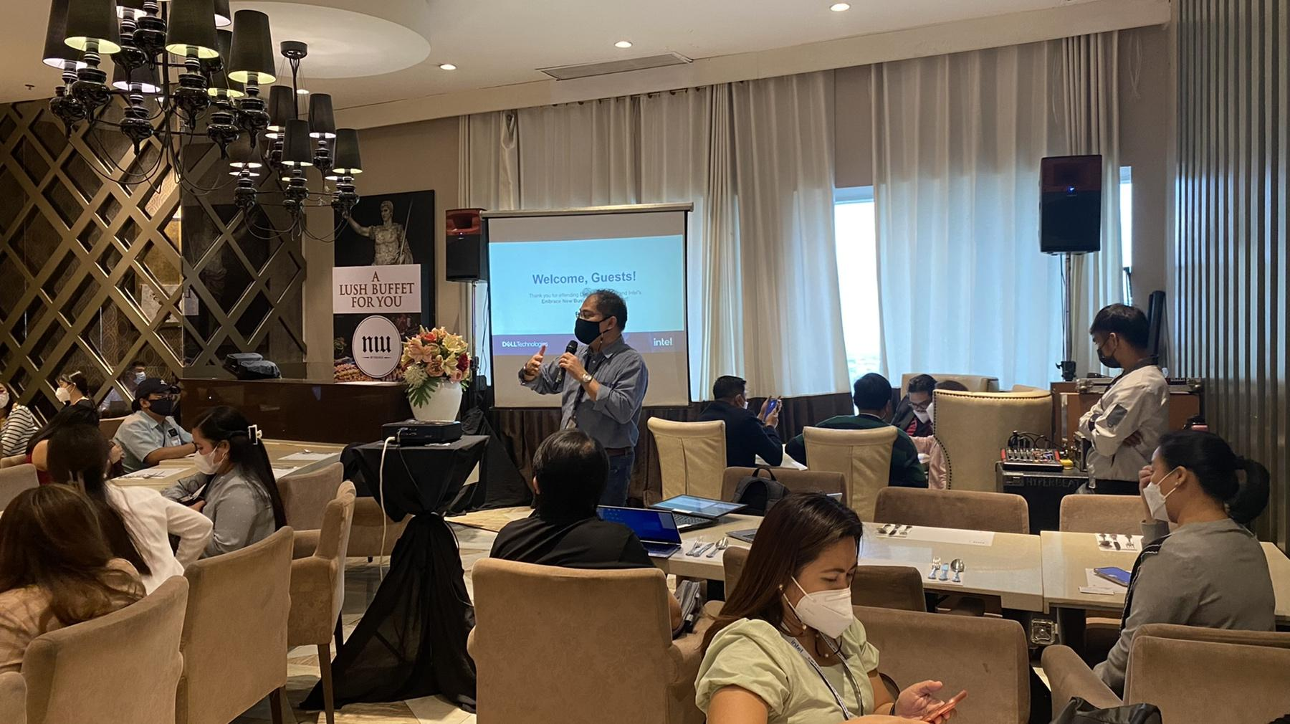
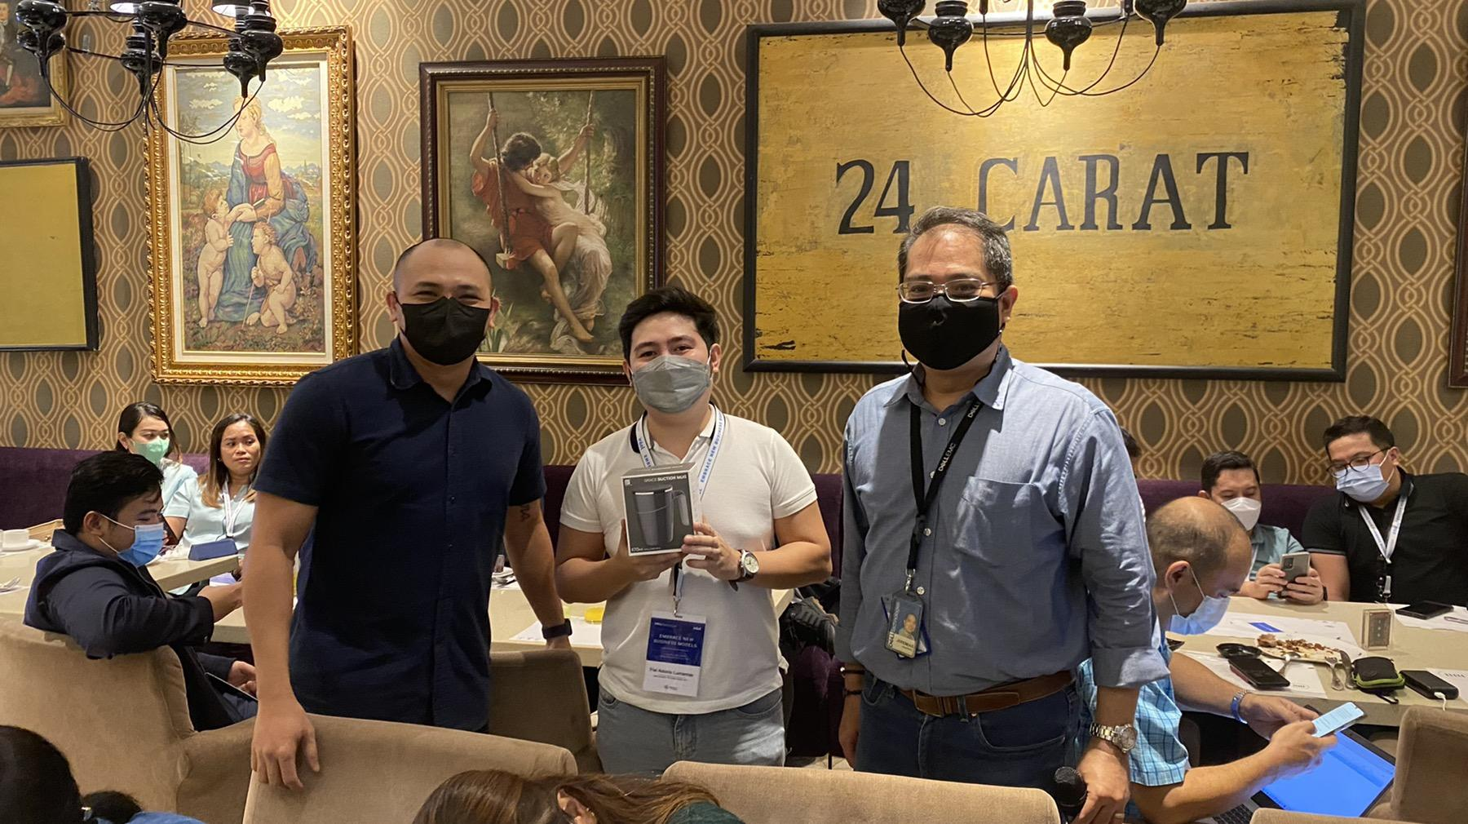
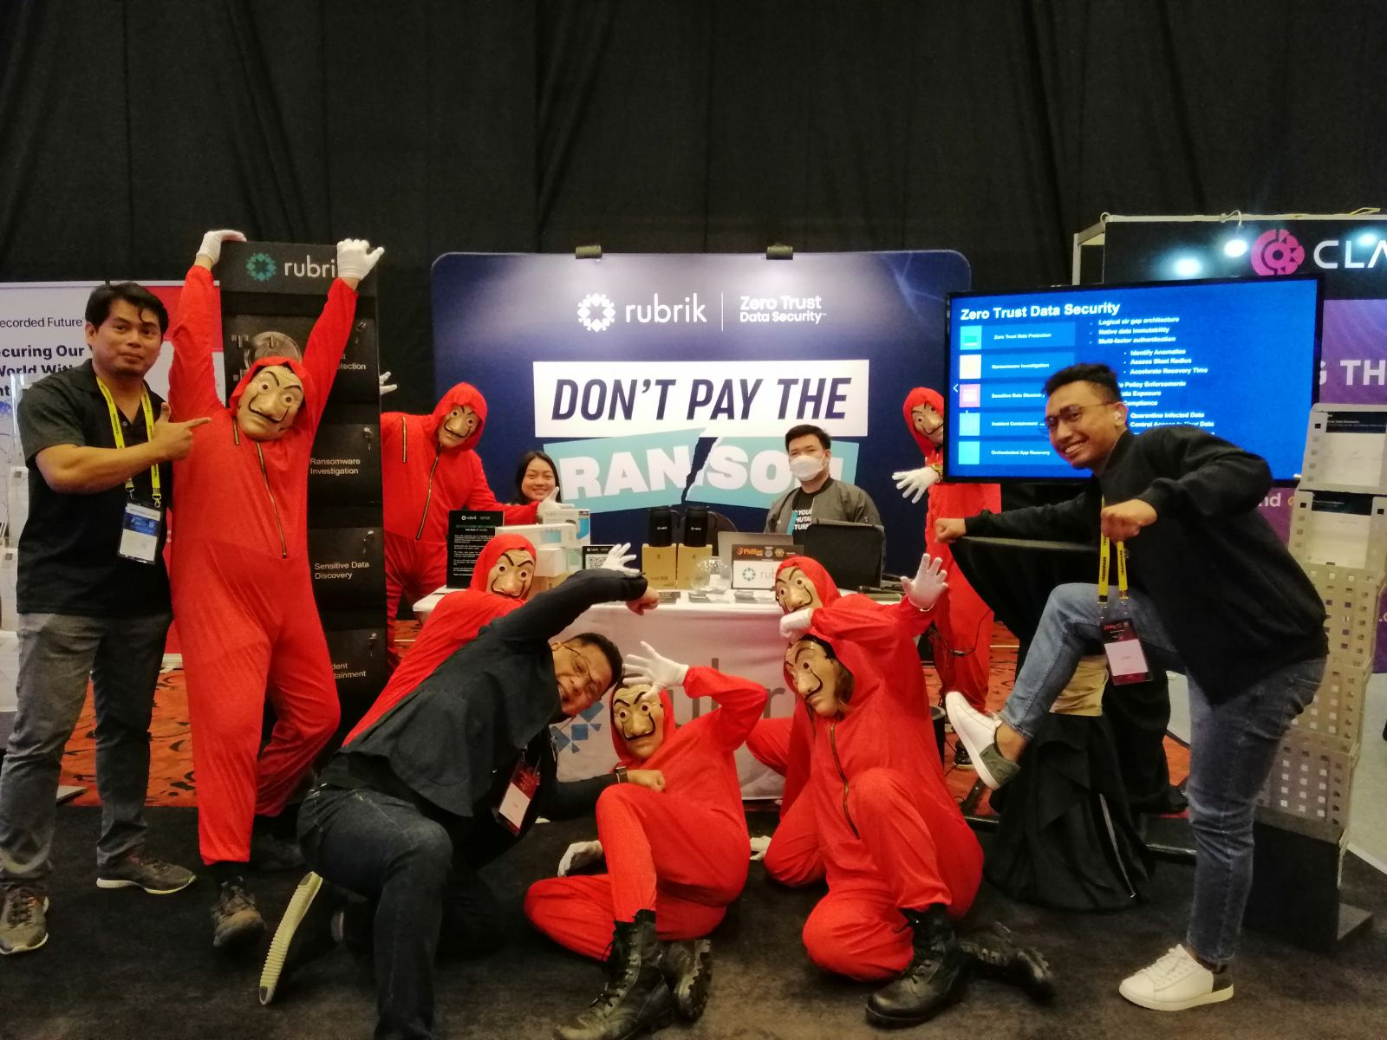
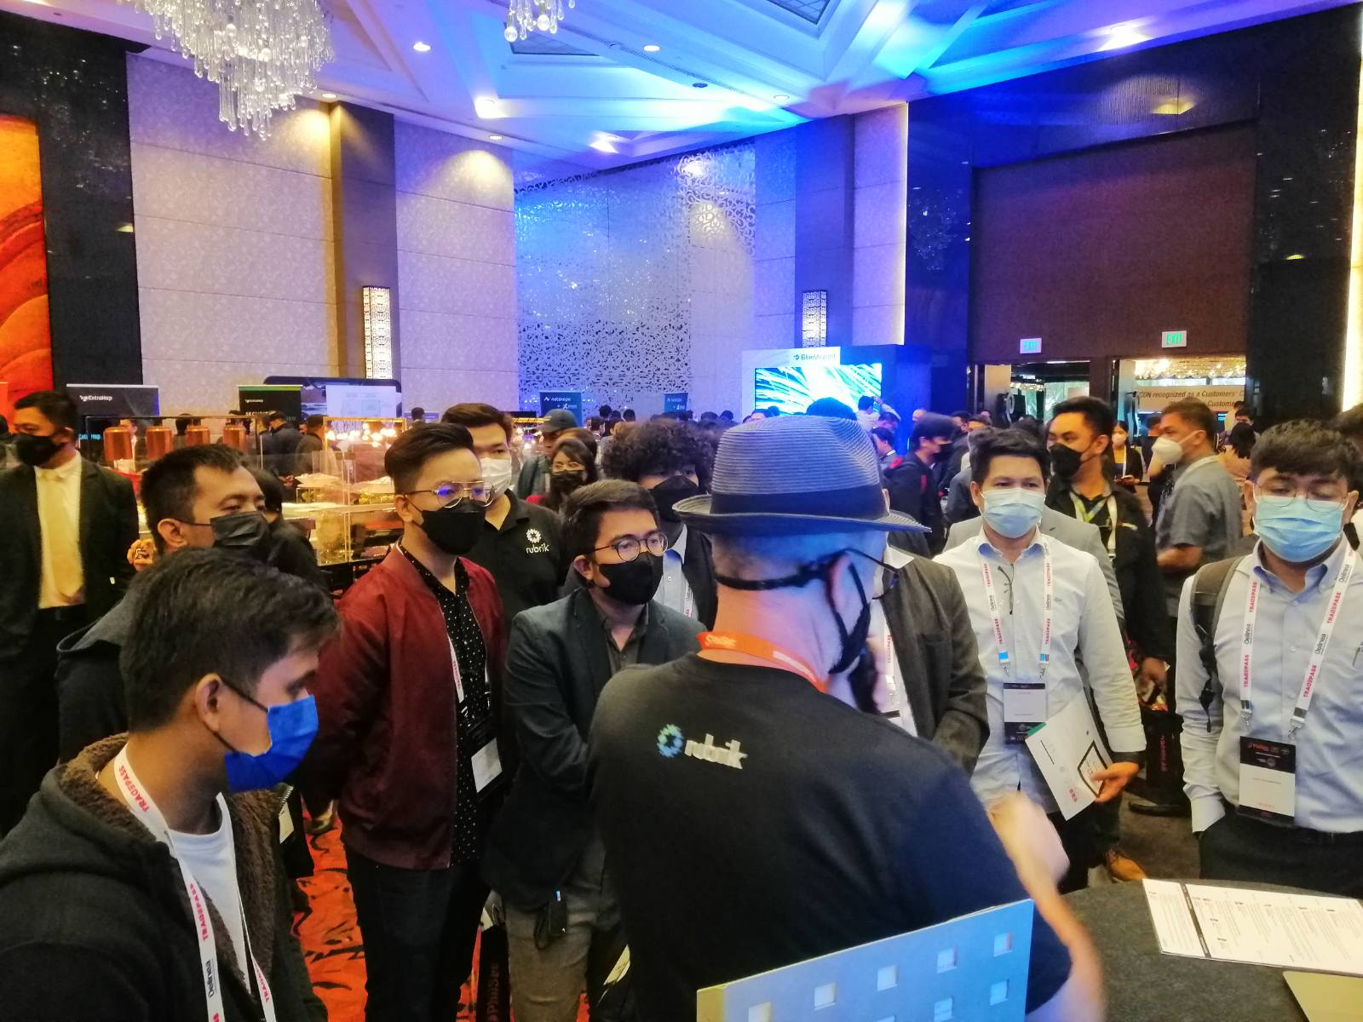
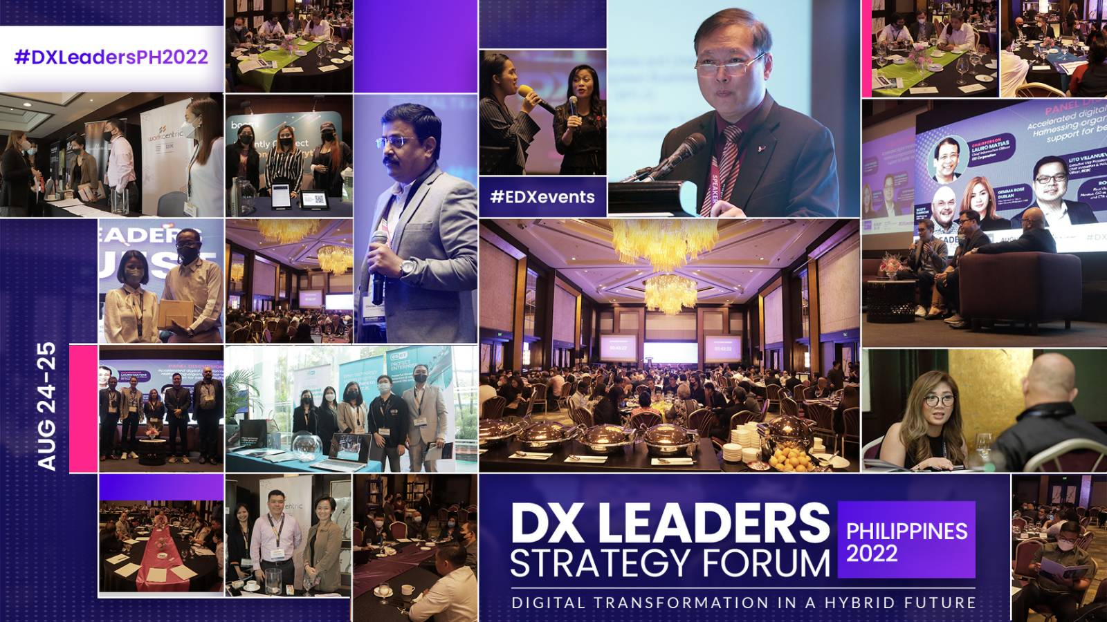
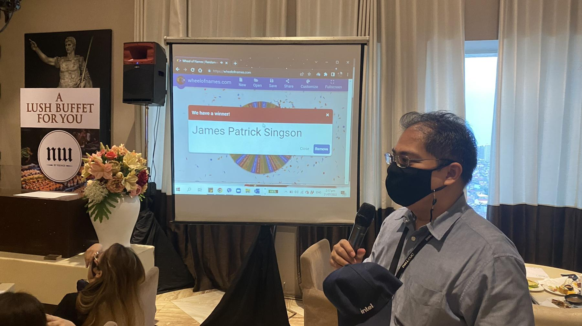
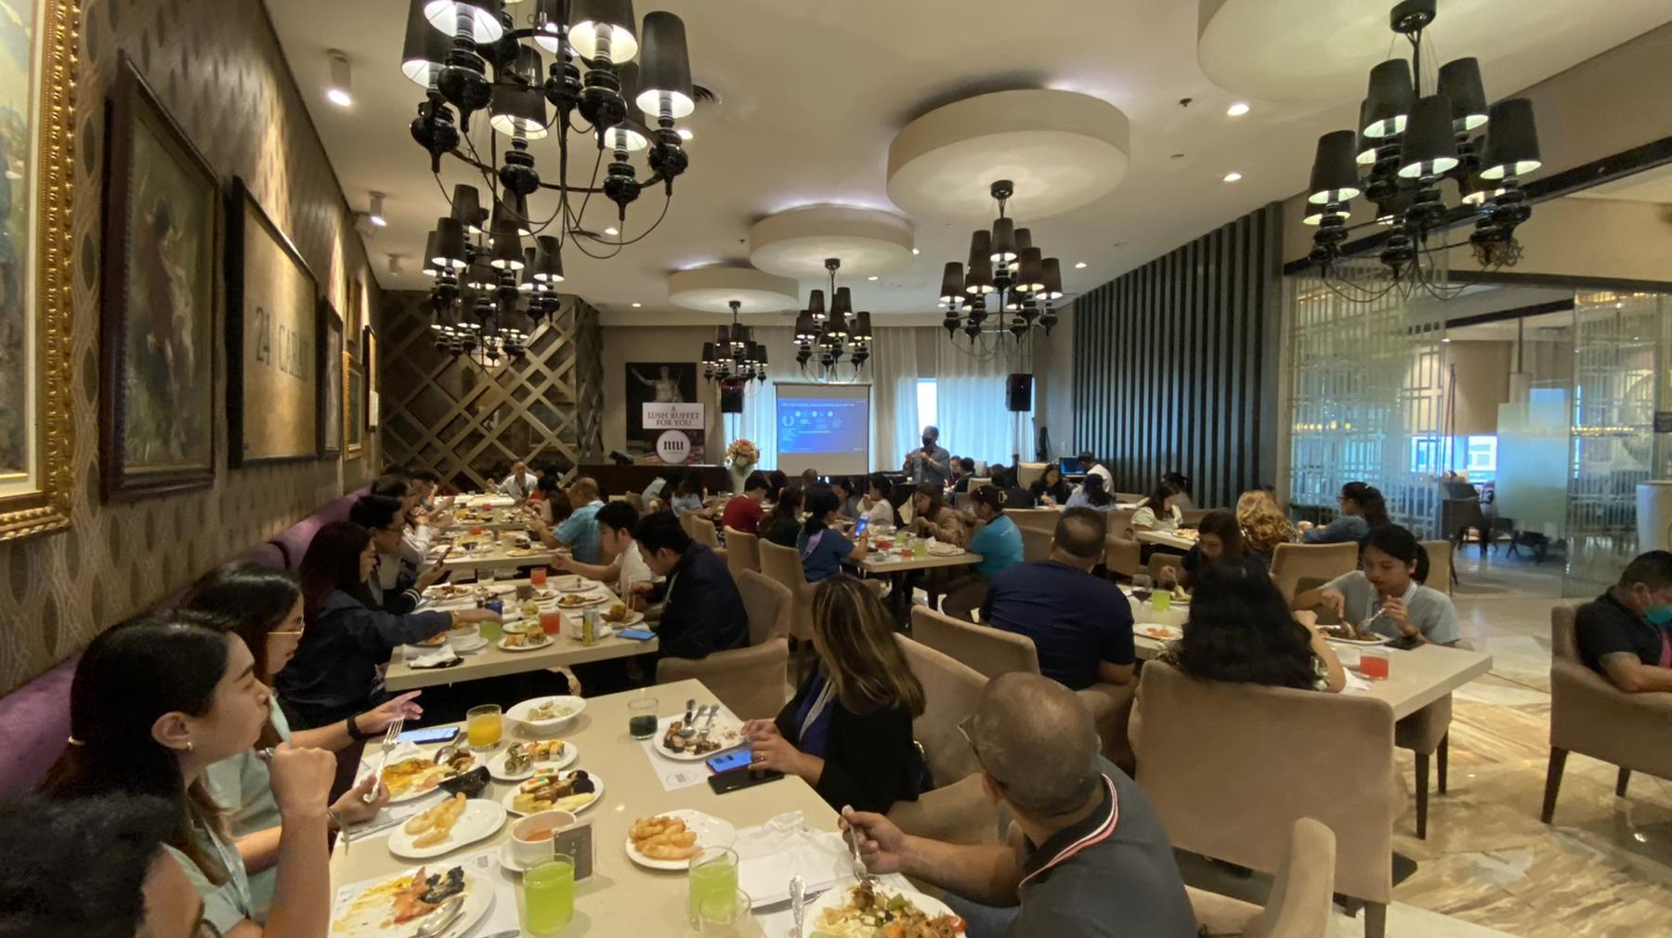
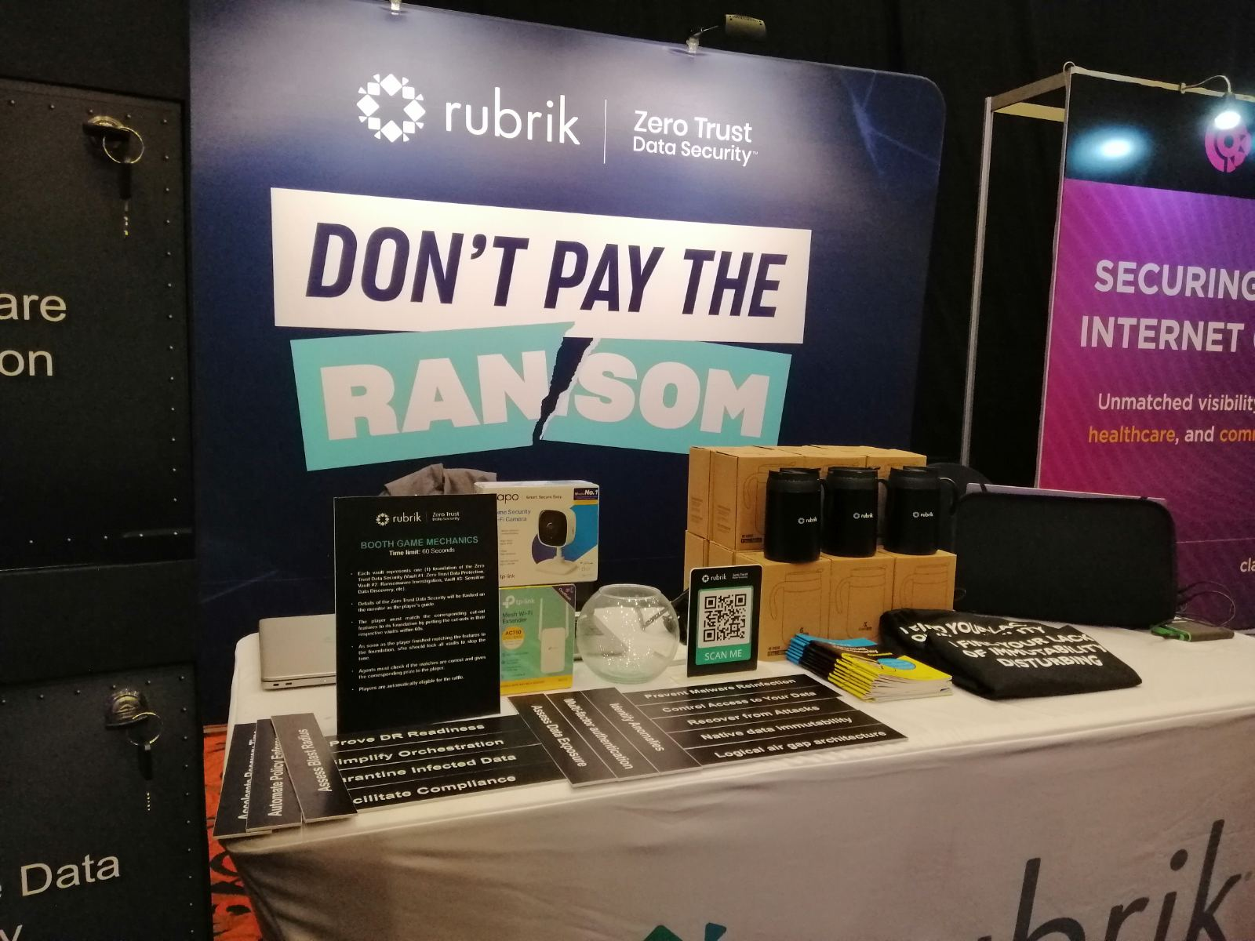
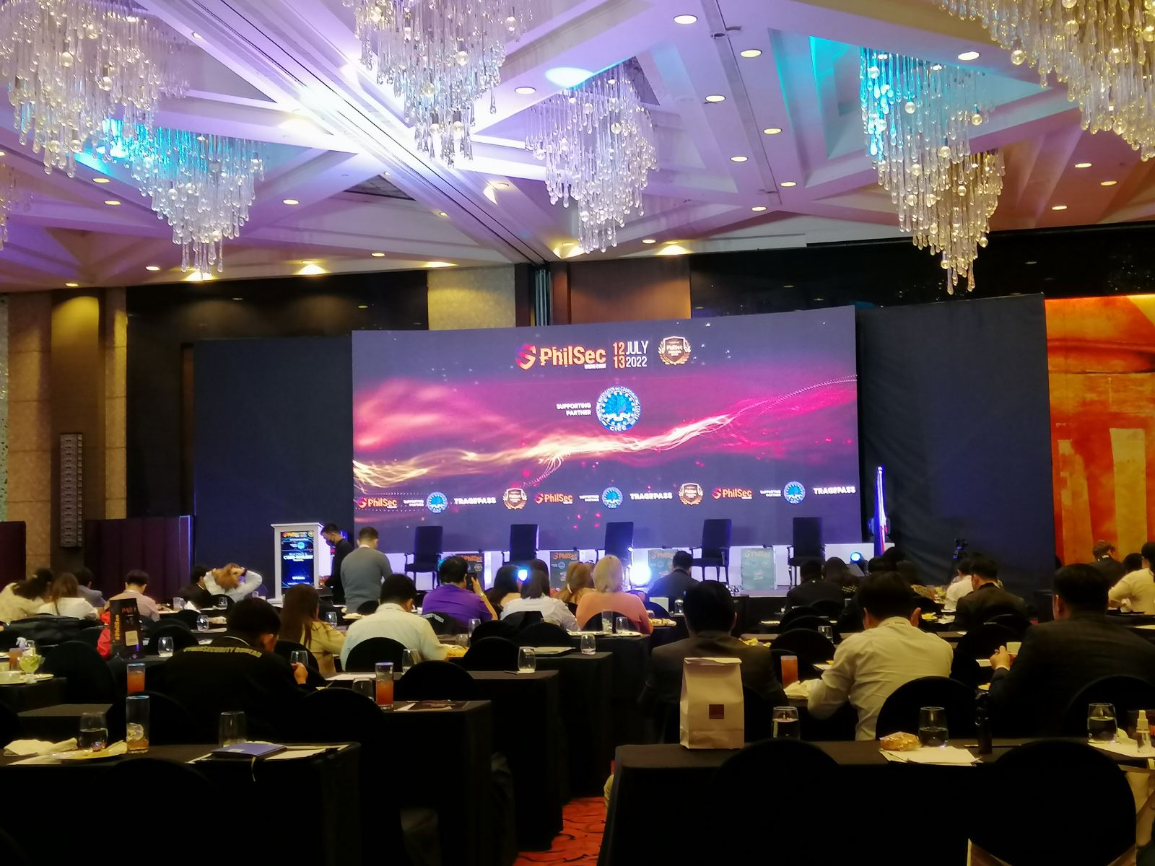
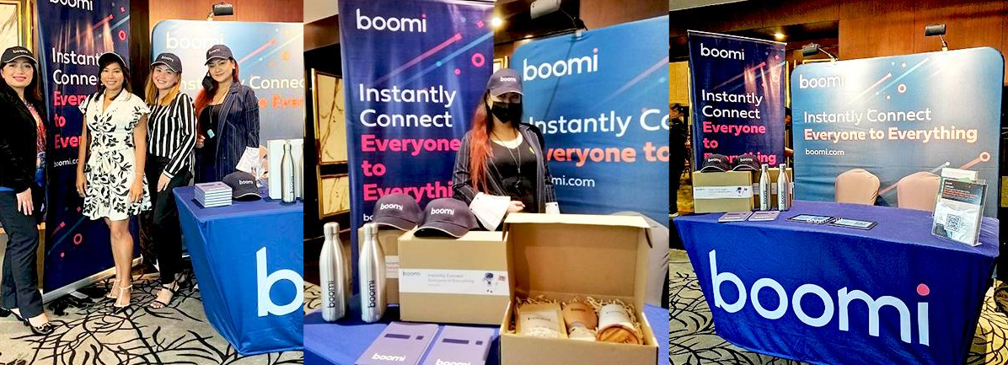
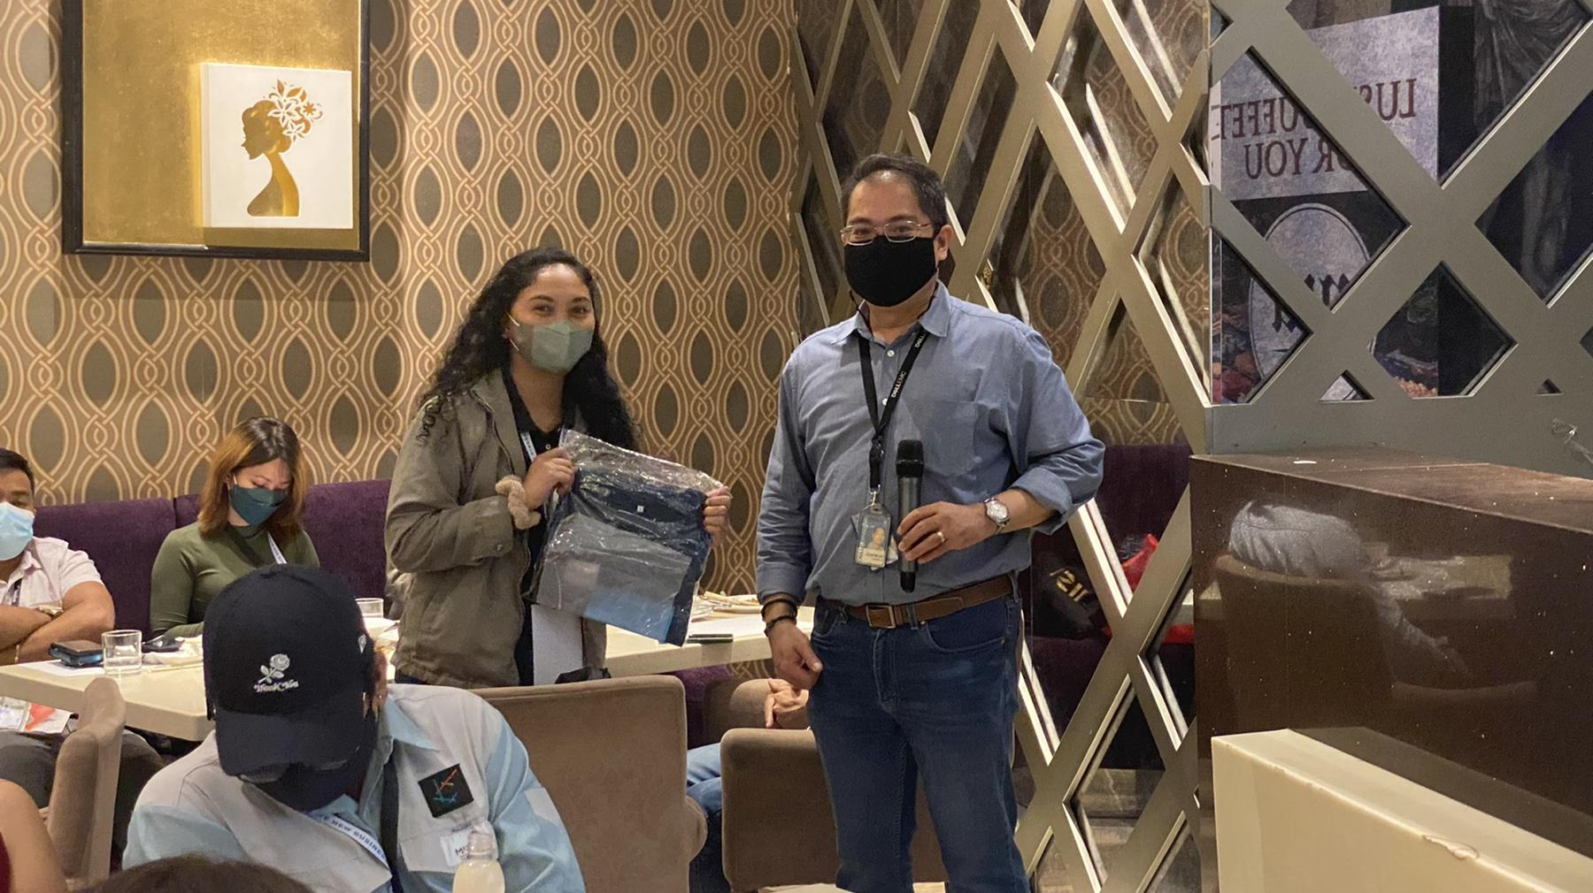
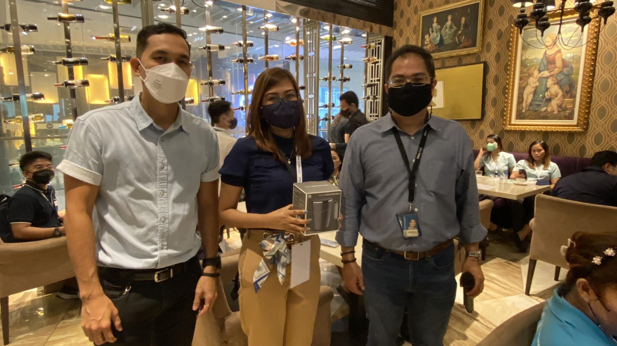


EVENTS & ACTIVATION
ON-GROUND
On-ground
Rubrik – Don’t Pay the Ransomware
Sofitel Philippine Plaza Manila
DX Leaders Strategy Forum 2022
Digital Transformation in a Hybrid Future
Diamond Hotel (Manila)
DELL OEM Solutions Lunch & Learn Event
NIU by Vikings, SM Aura Premier, BGC
Notes:
Dell Technologies, together with VST ECS, and Intel Philippines, held a lunch and learn event at NIU by Vikings, SM Aura Premier, BGC last July 2022. Attended by over 75 pax from various tech industries, the event helped address technology barriers in terms of infrastructure, software, and service s

Slide 6
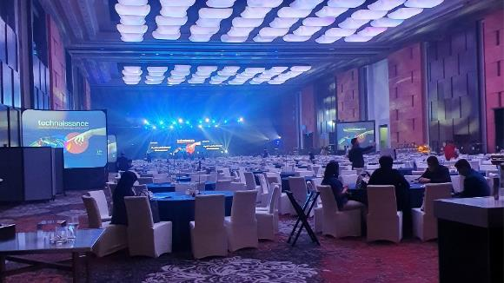
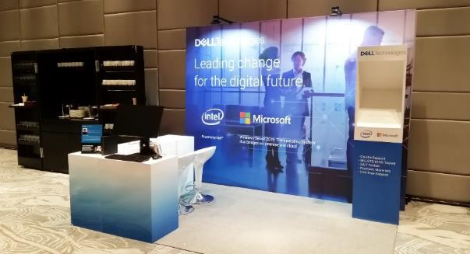
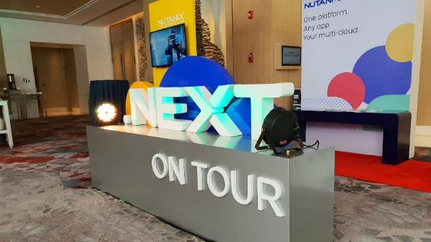
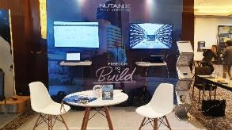
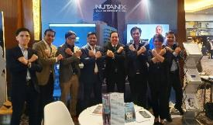
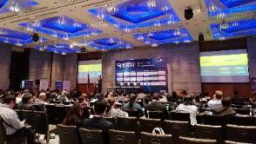
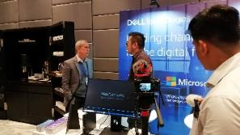
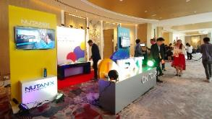
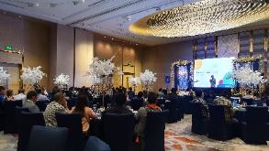
EVENTS & ACTIVATION
ON-GROUND
NUTANIX – Ayala ICT Summit
Shangri-La the Fort
DELL – Retail Banking Innovations
Philippines Summit
Marriott Hotel
NUTANIX – Next On Tour
Shangri-La the Fort

Slide 7

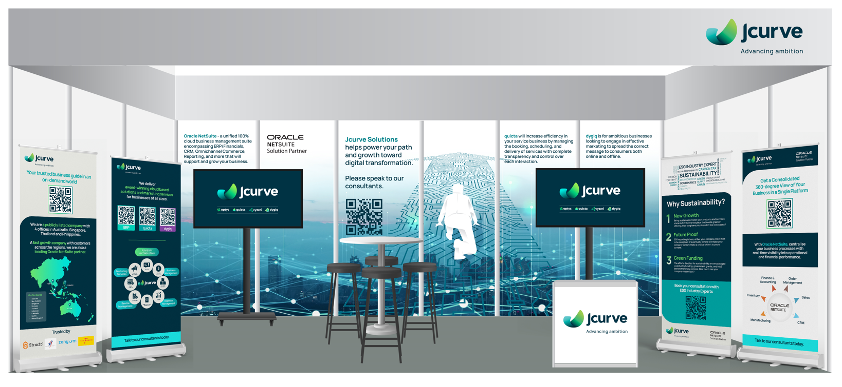
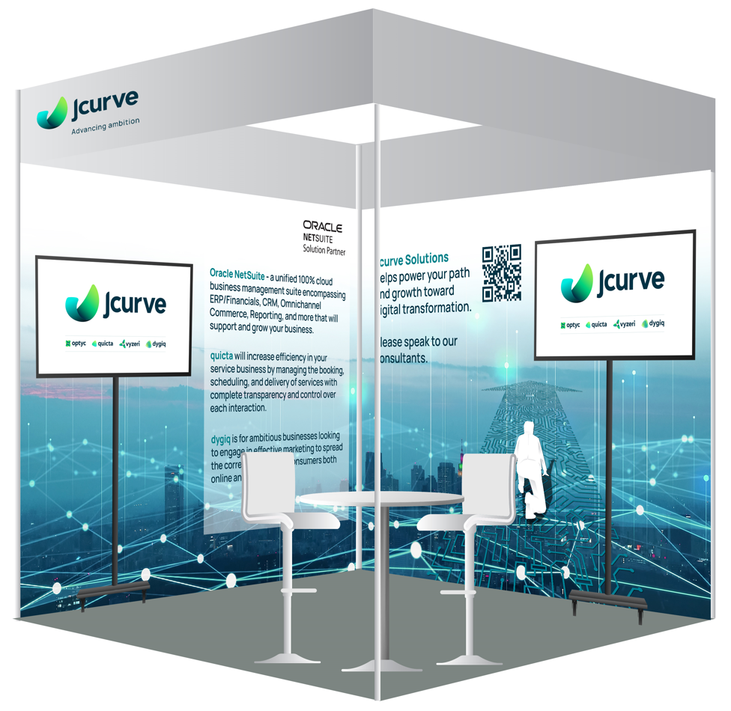
EVENTS & ACTIVATION
ON-GROUND
On-ground
Jcurve - SME Centre Exhibition
Singapore
Jcurve - Singapore Business Show
Singapore
Jcurve – Cloud Expo Asia
Singapore

Slide 8
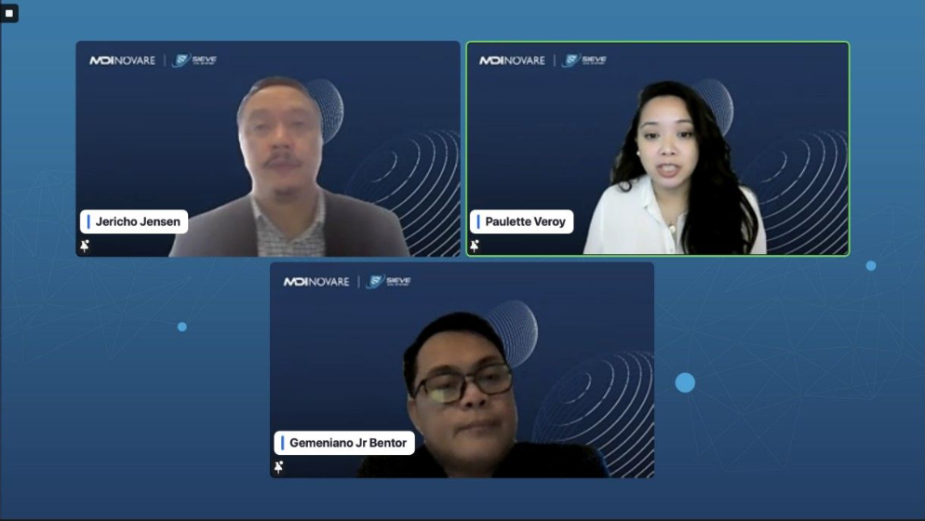
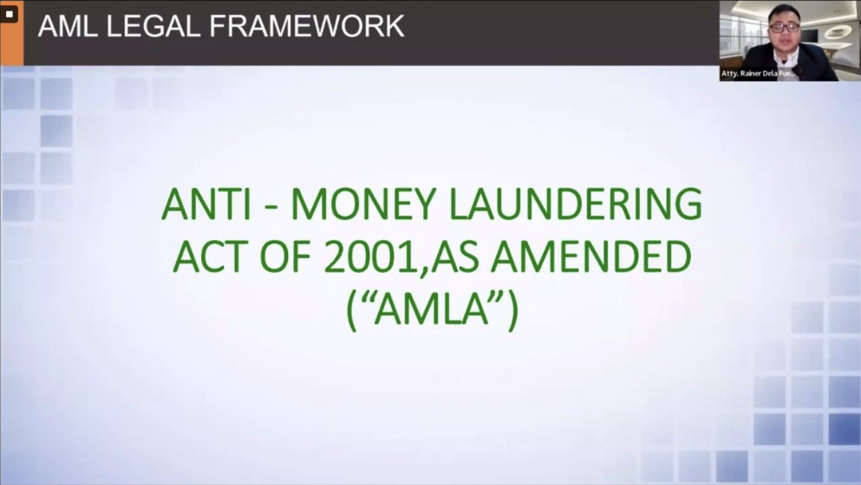
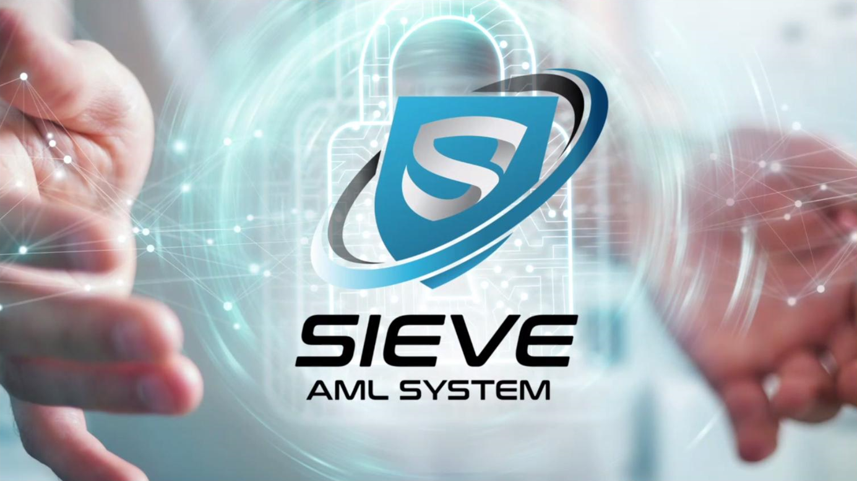

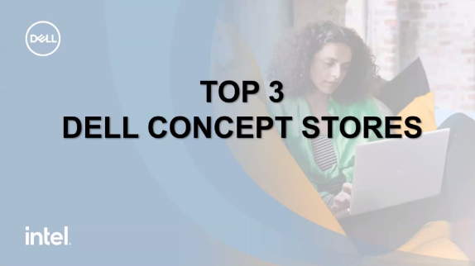
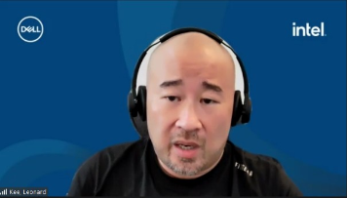
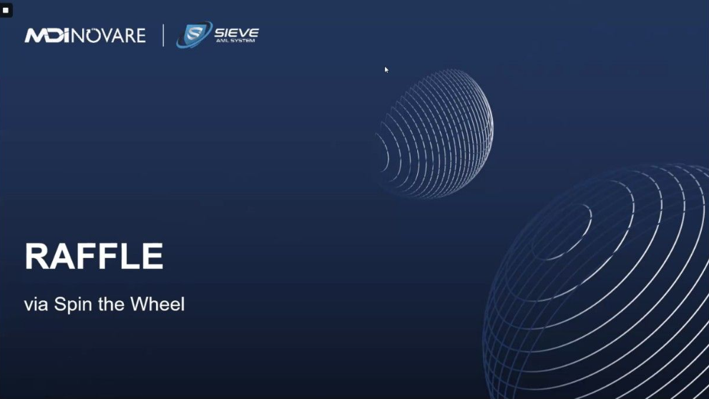
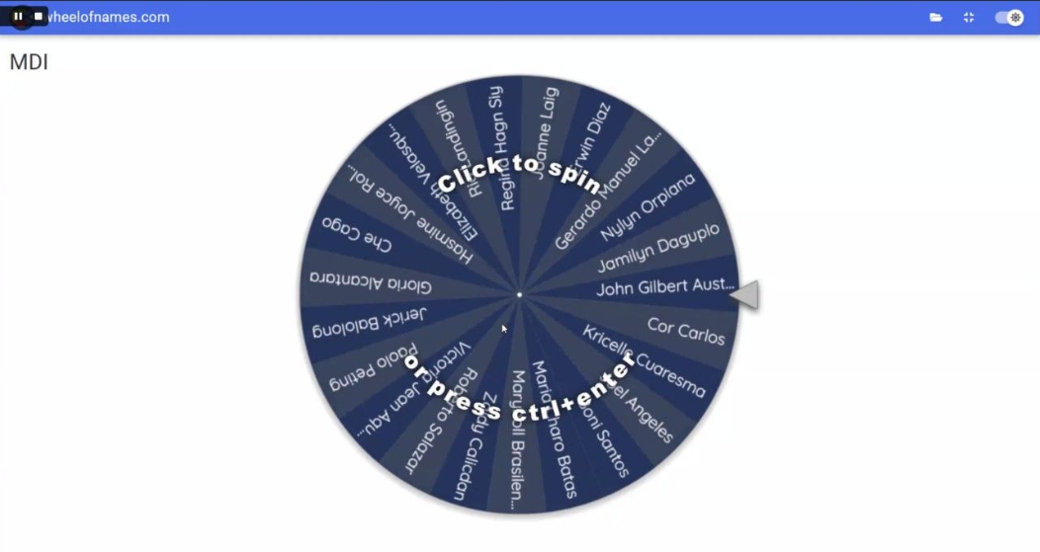
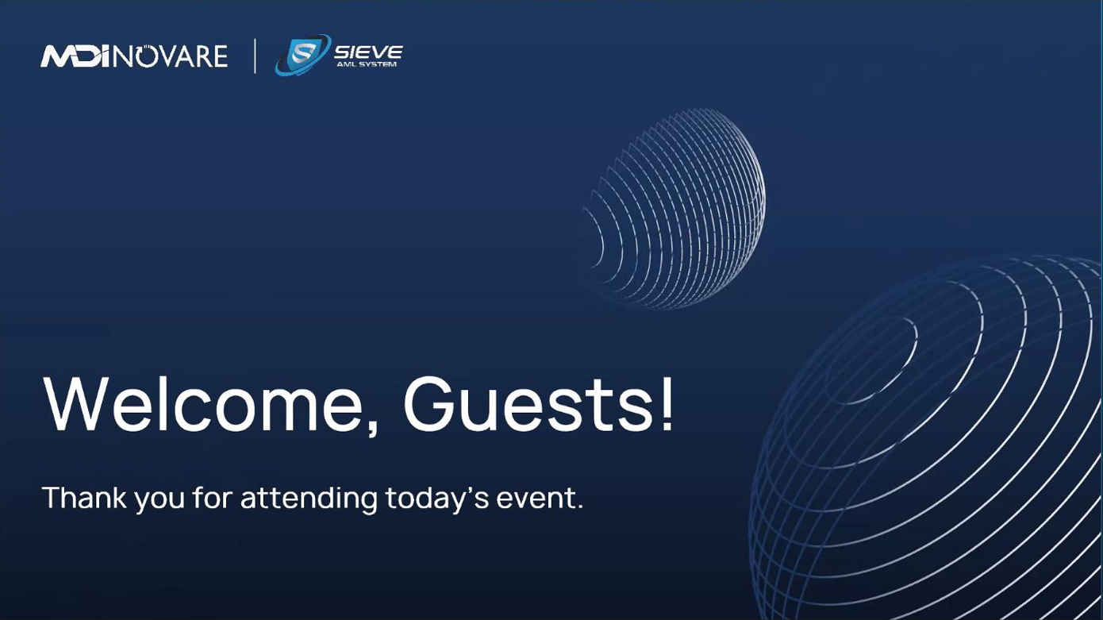
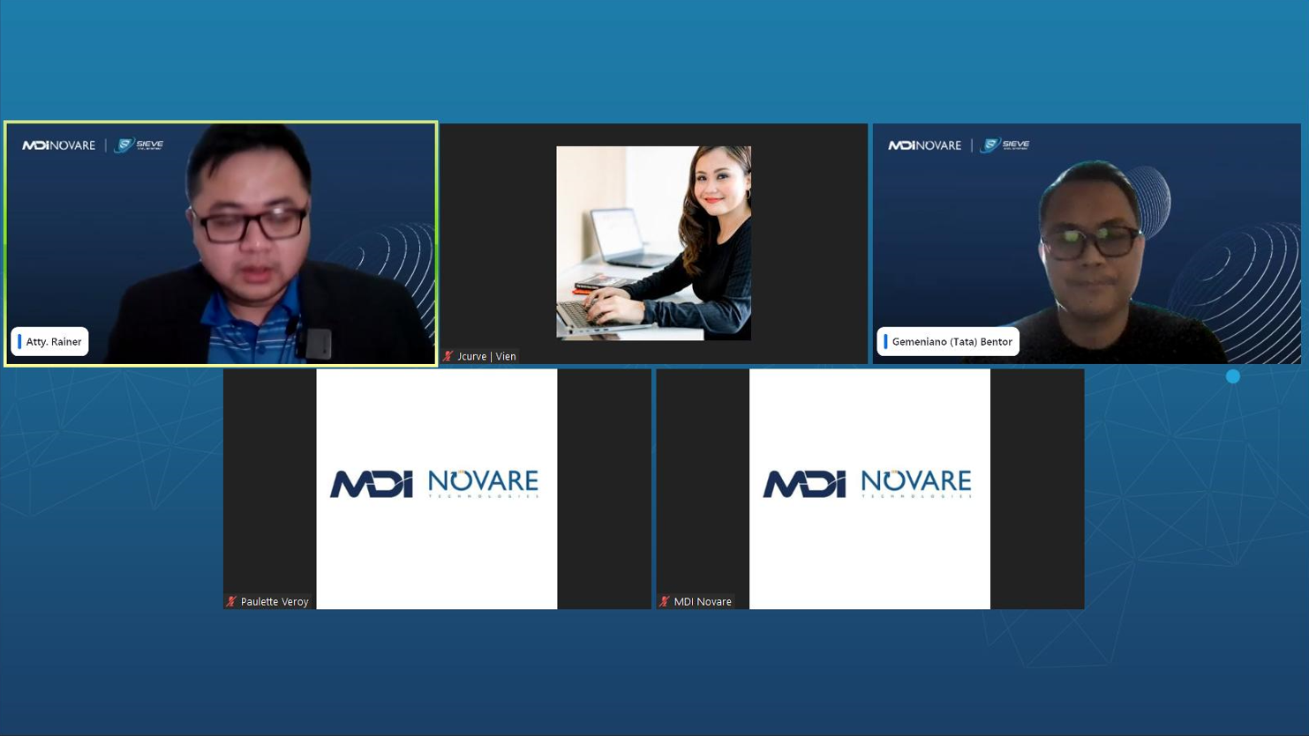
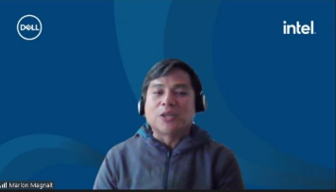
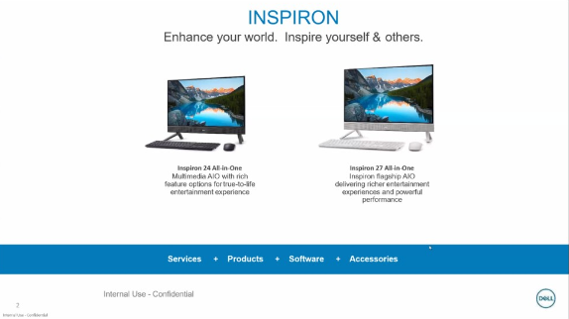
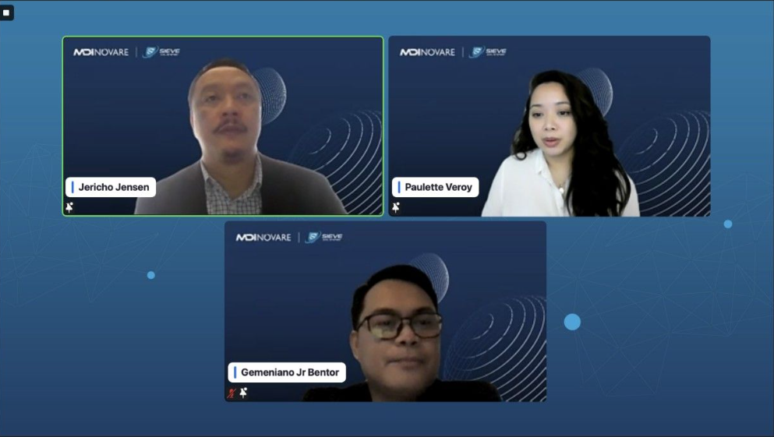
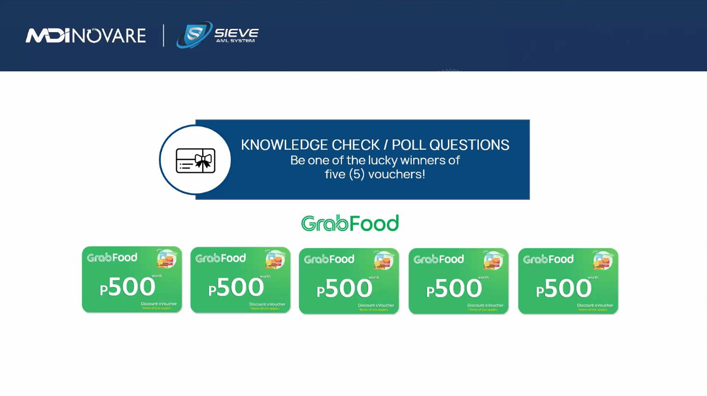

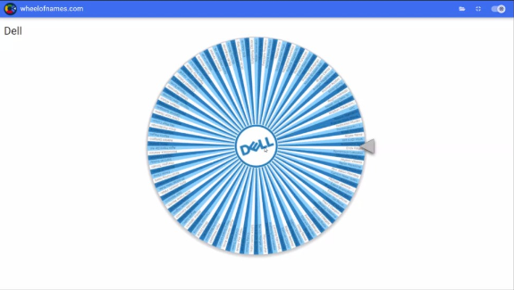
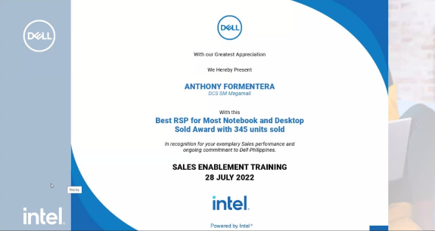
EVENTS & ACTIVATION
DIGITAL
MDI x Sieve Webinar
MDI x Sieve Webinar - How the Bad Guys Work: Protect Your Banks From Unauthorized Transactions
Dell - RSP Enablement FYR23Q2 Training
Attended by representatives from various rural banks in the Philippines, the event was joined by experts from Anti-Money Laundering Council who deep dived on the biggest dangers of money laundering - how cybercriminals clean their dirty money and what needs to be done to spot and combat these cons.
Notes:
MDI Novare x Sieve Webinar
MDI Novare, in partnership with Sieve, piloted the first half of their virtual event last September 2022. Attended by representatives from various rural banks in the Philippines, the event was joined by experts from Anti-Money Laundering Council who deep dived on the biggest dangers of money laundering - how cybercriminals clean their dirty money and what needs to be done to spot and combat these cons.

Slide 9
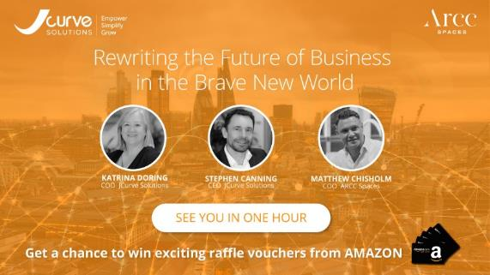
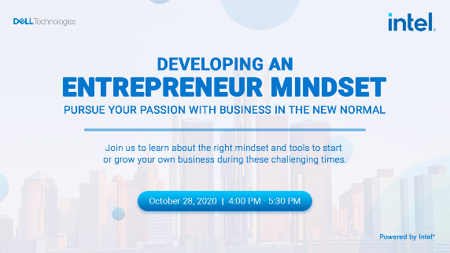
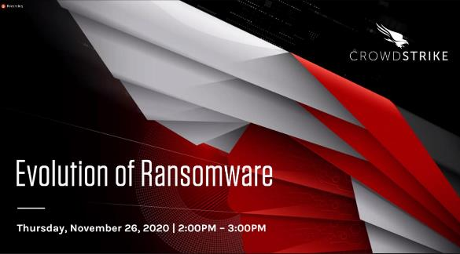
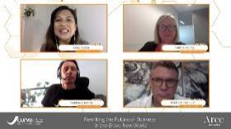
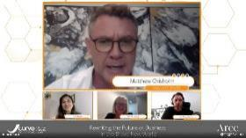
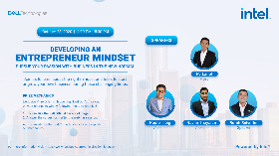
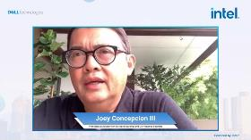
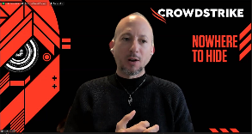
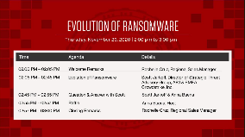
EVENTS & ACTIVATION
DIGITAL
JCURVE – Rewriting the Future of Business in the Brave New World
https://fb.watch/7VDWSBotZP/
DELL & GO NEGOSYO – Developing an Entrepreneur Mindset
https://fb.watch/7VE1x-aHjm/
CROWDSTRIKE – Evolution of Ransomware

Slide 10
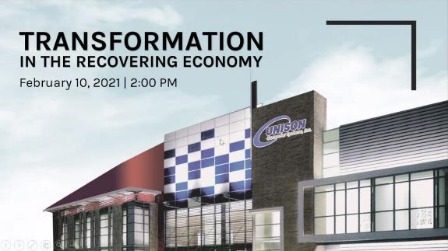
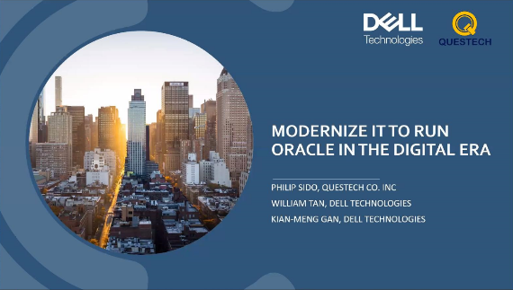







EVENTS & ACTIVATION
DIGITAL
DELL & UNISON – Transformation in the Recovering Economy
DELL & QUESTECH – Modernize IT To Run Oracle in the Digital Era
COMMVAULT & HITACHI – Securing Your Digital Assets with Hitachi Vantara and Commvault’s Intelligent Data Protection and Recovery

Slide 11






CREATIVES & MULTIMEDIA
VIDEO
Jcurve - Fireside video
RIYO - NETSUITE Introductory Video Clip
Jcurve – Brand Launch
NETSUITE Video Explainer
JCURVE SOLUTIONS – Web Teaser
PSIS– On Stream

Slide 12






CREATIVES & MULTIMEDIA
STORE RENOVATION

Slide 13




CREATIVES & MULTIMEDIA
BROCHURES

Slide 14








CREATIVES & MULTIMEDIA
CONTENT DEVELOPMENT

Slide 15





DIGITAL
WEB DEVELOPMENT
Jcurve - Website
www.jcurvesolutions.com
Optyc - Website
www.optic.com
Quicta- Website
www.quicta.com
Vyzeri - Website
www.vyzeri.com
RIYO BLOG - Website
www.riyo.io

Slide 16














DIGITAL
SOCIAL MEDIA / SPONSORED ADS
C
A
R
O
U
S
E
L

Slide 17






DIGITAL
SOCIAL MEDIA / SPONSORED ADS

Slide 18









DIGITAL
GOOGLE DISPLAY
Singapore
Philippines
Australia
Generic
Cleaning Services
Dry Clean and Laundry
Home Repair

Slide 19



DIGITAL
SEO

Slide 20


CLIENTELE
Trusted by Industry Leaders
Primarily Serving the IT Industry
Our clientele includes leading businesses in the IT industry.
We've had the privilege of partnering with renowned companies, delivering successful campaigns and impactful marketing strategies.

Slide 21





LEADERSHIP
Guided by Visionaries
Meet [Managing Director's Name]
At the helm of Creative Quest is Ann Viloria, a visionary with 23 years of solid marketing background from reputable IT companies. Ann leads the agency
towards continuous innovation and excellence.
Founder, Viloria Group, Inc.
Co-Founder, Blue Chamber One Inc.
Co-founder, Naturaleza Wellness
Outstanding Marketing Alumni
Pamantasan ng Lungsod ng Maynila
MBA Regis – Ateneo Graduate School of Business (Former Director – AGSB Chamber of Commerce)
Marketing Awardee
Dell EMC and Microsoft Dynamics
ESSCA Ecole de Management (Shanghai) Alumni
SEO and Google Analytics Certified
Former EVP of JCI San Juan
Adobe Graphics and Web Design Certified

Slide 22





WHY CHOOSE US
Strategic Approach
Meticulous planning and deep market understanding.
The Creative Quest
Advantage
Creative Excellence
Innovative designs that make your brand stand out.
Customer-Centric Focus
Your success is our success. Collaborative work with your goals at the core.

Slide 23

SUCCESS STORIES
Our Impact
From Vision to Reality.
Showcase successful campaigns, events, and transformations with before-and-after visuals.
Highlight key metrics and achievements.
Good example
Notes:
Insert Images (Campaigns/Events/Creatives)
Insert Screenshots (Graphs/Percentage)
TBD

Slide 24




Let's Create Something Extraordinary
+639 98 886 3386
marketing@creativequest.asia
www.creativequest.asia

Slide 25


